Slide 1
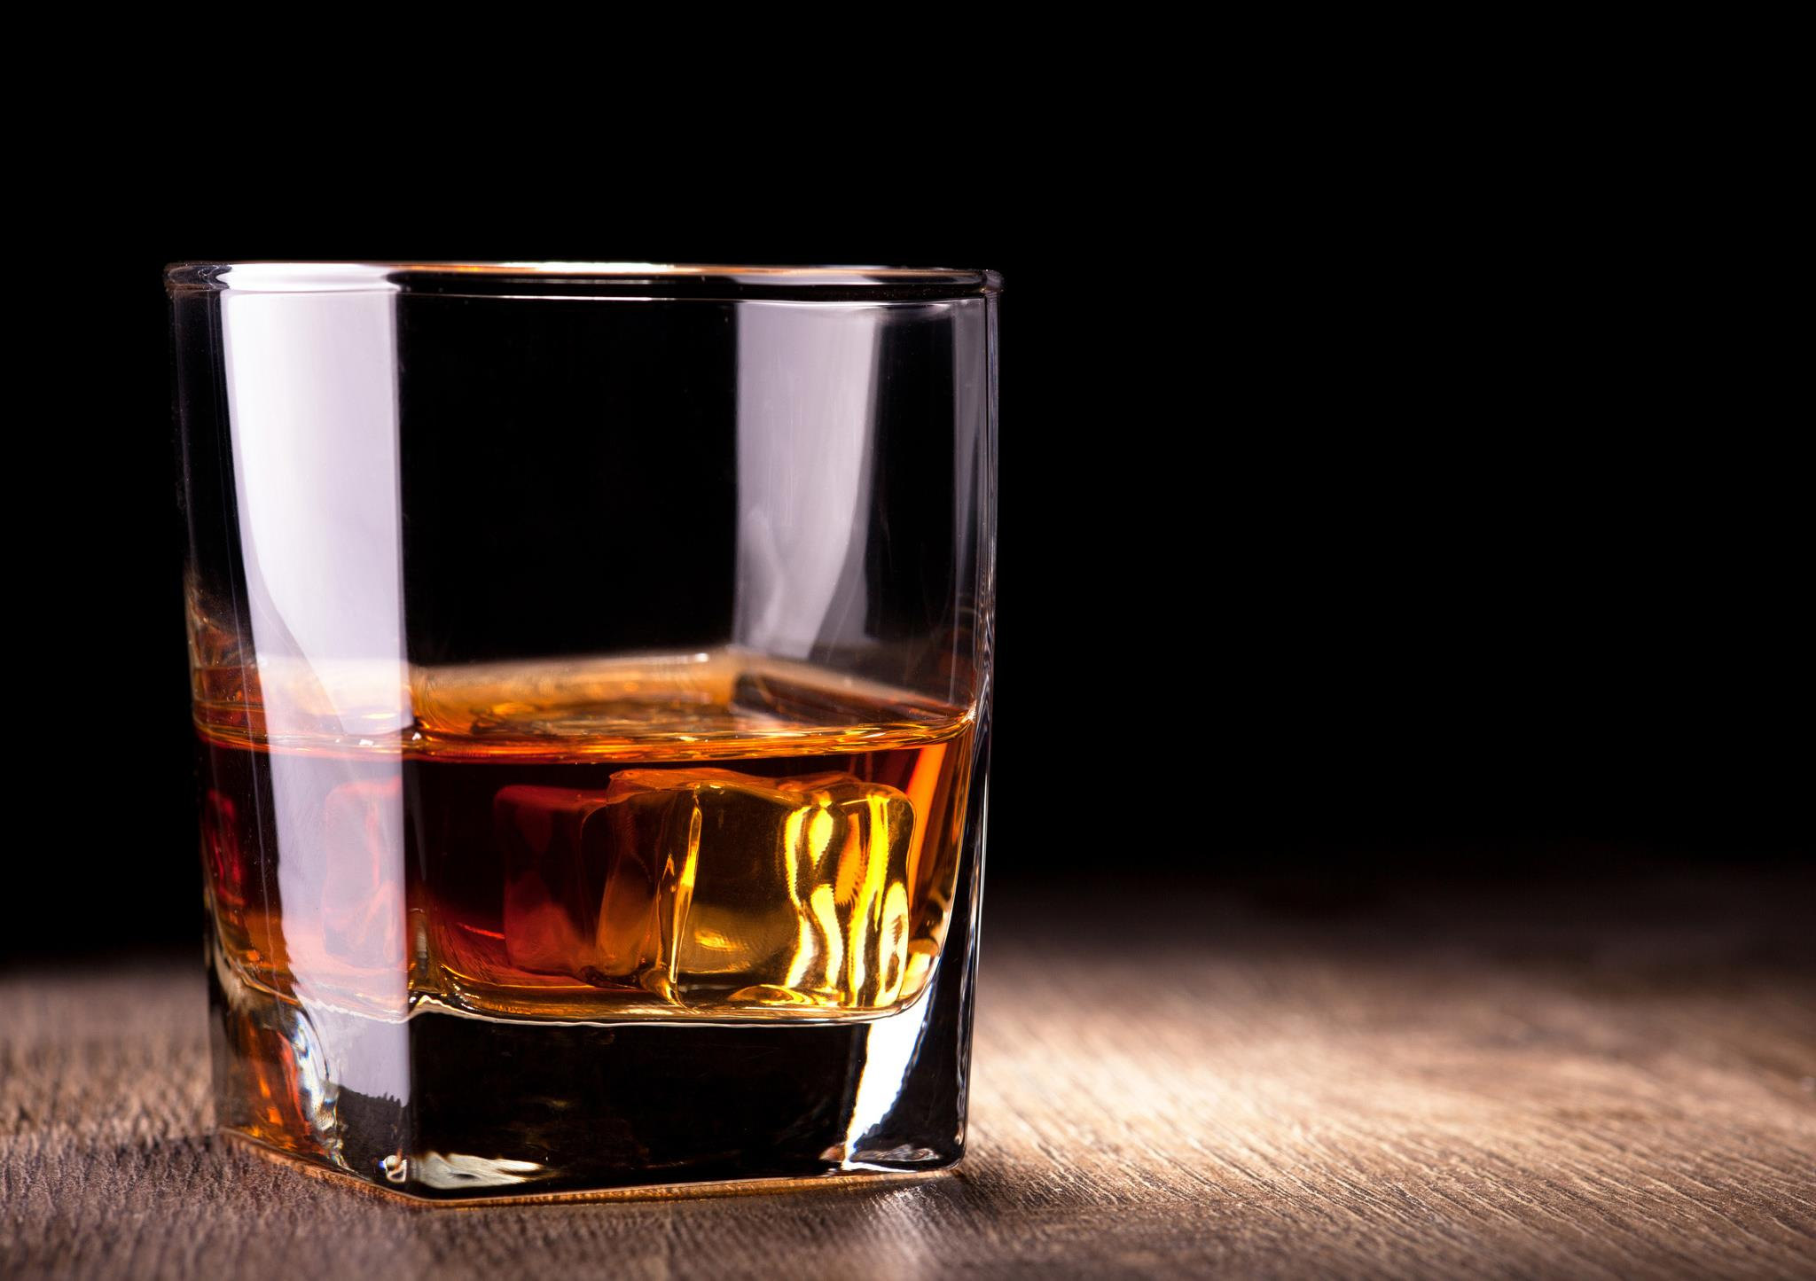
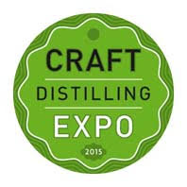
The Future of Distilling
Craft Distilling Expo 2015
October 7th 2015

Slide 2


Introduction: What is it about?
Join Odin of iStill for a 21st century take on the art of distilling
The session will cover some of the recent and future developments and innovations in distilling and distillation equipment
And exciting new technologies!

Slide 3
Introduction: Why?
Why should we change the art of distilling?
Why do we need innovations and new technologies?
Why do they need to be exciting?

Slide 4
Because craft distilling is changing!
Craft Distillers gain shelf space from big distilleries;
Counter measure: big brands both diversify and buy Craft Distillers;
More and more Craft Distillers enter the market, causing:
  Fight for shelf space among Craft Distillers, creating a need for:
  Quality control and product differentiation;
  Cost leadership

Slide 5
Quality control and product differentiation
Q1: How to make better product than your neighbour?
A1: Total process control
Q2: How to differentiate your product from your neighbour’s?
A2:Versatile equipment, creative mind!

Slide 6
Cost leadership
Q3: Why do you need Cost Leadership?
A3: Because it allows you to outcompete other Craft Distillers in the long term
Q4: How do you establish Cost Leadership?
A4: By producing more efficiently than your competitors

Slide 7
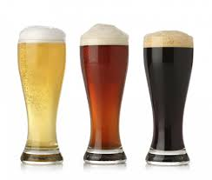
Craft Brewing: a great example!
Craft Brewers gain shelf space from big breweries;
Counter measure: Big Beers both diversify and buy Craft Brewers;
More and more Craft Brewers enter the market, causing:
  Fight for shelf space among Craft Brewers, creating a need for:
  Quality control and product differentiation;
  Cost leadership

Slide 8
Craft Brewing: their answers
Heavy investment in total process control for batch quality consistency;
Product differentiation (think IPA!) via emphasis on product development and small batch production;
Master Brewers emphase efficiency rather than tradition!

Slide 9
What Craft Distillers can do?
(provocative)
Cut off your beards!
If you come in from a hobby perspective, realize it is a job … and more;
Start producing fruit brandy from tomorrow onwards;
Forget about distilling, focus on fermenting;
Replace your big distillation devices by thousands of smaller units;
Under pressure everything becomes fluid … so push for pressure!

Slide 10
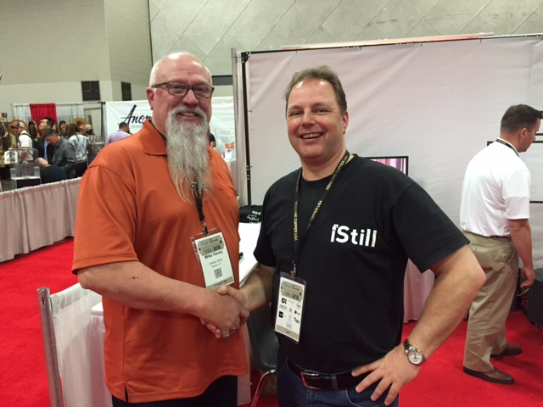
Cut off your beards!
Craft Distilling is not about the traditional ways;
Remember how traditional small scale distilleries died out almost a century ago?
If you don’t want to be among the next extinction wave … trim that beard, become innovative, and start creating the wave instead of riding it!
So many “Assumptions of Old” rule today’s thinking on how Craft Distilling works;
If you want to become a Craft Distiller (or remain one), start asking “WHY?” instead of accepting answers as if they were given facts.

Slide 11
Stills need to be made from copper
This is a conviction or assumption, not an answer!
My reactions (rather sceptic) would be:
R1: “Yeah, if you don’t mind cleaning extensively before the next run!”
R2: “Sure, if you love copper particle contamination in your drinks!”
R3: “So … you want to heat up the still room?”
R4: “If you can afford buying and running them!”

Slide 12
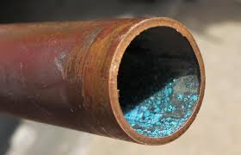
Stills need to be made from copper
The real answers:
Copper is beautiful but comes at a price: it is expensive, inefficient, and it rusts;
Copper controls sulfuric compounds, so it definitely plays a role;
But a stainless still with a copper catalyst may control sulfuric compounds just as well (cheaper, easier, more efficient, not so beautiful).
If you ask “WHY!”, and find the real answers, you end up being better informed. For sure, the additional knowledge will help you make better choices.

Slide 13
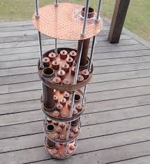
Bubble Caps vs Perforated Plates
Benjamin Franklin:
“Bubble Caps are for batch production, Perforated Plates are for continuous production.”
Again, this is a conviction or assumption, not an answer!
My questions would be (rather straight forward this time):
Q1: “So if you do a continuous strip on the grain … how does the grain travel through the small perforations?”
Q2: “While batch producing whisky or rum … what design is better?”

Slide 14
Bubble Caps vs Perforated Plates
If you ask “WHY?” you may find out that:
Both designs have their pro’s and con’s;
These pro’s and con’s may have more to do with flavor profile than with “continuous stripping” vs “batch production”;
If you want to strip on the grain, choose a Bubble Cap design over a Perforated Plate, but make sure the Caps are really big;
Bubble Caps, due to their stable plate baths, have almost complete Tails control;
Perforated Plates allows you to easier harvest early Tails (more on that later).
The result of asking “WHY?”: depending on your products and procedures, you can now make better decisions.

Slide 15
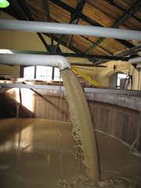
Ferment whisky beer in 48 hours!
This is a conviction or assumption, not the definite answer to the question “How long does a whisky ferment needs to run, prior to distilling?”
My reaction:
Esterification takes place where organic compounds and alcohol meet in a sour environment;
A 5 day fermentation cycle gives you more taste, even when the total ABV gain is low.

Slide 16
Ferment whisky beer in 48 hours!
Why this conviction?
Because in non-heat controlled ferments the heat starts to kill the yeast after 48 hours (> 34 Celsius);
Because single malt is prone to lactic bacterial infections, so overpitch and ferment fast (hmmm ... faster is hotter)
With this additional information you now have the choice to maybe work with heat controlled fermenters or have fermentation times depend on the taste profile you are after.

Slide 17

It’s not a hobby, it is a job!
If you like making drinks, if you like drinking drinks … do realize Craft Distilling is a job;
Full-time and more;
Hard, physical labour;
It may start out as fun, it will end up providing you money or helping you go bankrupt.
Distillers Myopia 1: looking for what you like vs seeing what you need to do (cleaning, pumping, stirring, sweating)

Slide 18
It’s not a hobby, it is a job!
Instead:
Look at the process (grinding, pumping, malting, stirring, pumping again, cleaning some more, etc.)
Optimize that process in such a way that it is the least labour intensive;
Create a production flow without (unmanageable) bottle-necks;
Only then choose the equipment that supports your process;
(And make sure you organize the distillery in such a way that distilling stays a hobby afterall. Have fun. Create new drinks. Differentiate yourself, the story and the drinks you make and sell!)

Slide 19
Start making fruit brandy!
Question:
“Why should we make fruit brandy? Does fruit brandy have such a big market or production potential?”
Answer:
“No, and given the English climate … NO! But if you buy fruit brandy stills, you may as well use them for what they are designed to do best, right? And that’s fruit brandy making.”

Slide 20
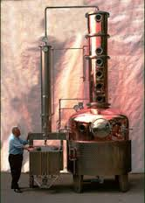
Start making fruit brandy!
Holstein is world market leader in distillation equipment;
They sell what’s basically a fruit brandy still;
If Craft Distillers from all over the world buy fruit brandy stills … that must be because they want to make fruit brandy, right?
Put differently: buy the right still for your product! Or: produce the right product, given your still’s design;
Let’s dive in deeper!

Slide 21
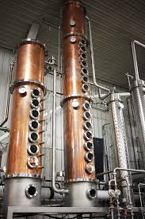
The right still for your product …
Rum still for rum, whisky still for whisky, vodka still for vodka?
Doesn’t it all boil down to plates? Many for vodka, a few less for rum and whisky? Maybe a hybrid still with 3 or 4 plates on top of the boiler, and a few dozen more on a separate column?
No, that would be Distillers Myopia 2 where the Craft Distiller focuses on plates.

Slide 22
The right still for your product …
Let’s shift that paradigm, because distilling great product is not about plates at all.
Instead, distilling great product is about two things and two things only:
  Managing vapor speeds;
  The art of smearing.
Plates offer a way to handle vapor speed and smearing, but other options are available (each with their own strengths and weaknesses);
Understanding vapor speed and smearing is essential for making great product.

Slide 23
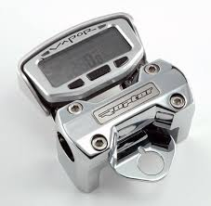
Vapor speed management
Vapor speed is about the speed of gases in the column;
More energy input = higher vapor speed / less energy input = lower vapor speed
Smaller diameter column = higher vapor speed / wider column = lower vapor speed;
Why vapor speed is important? Because it influences what alcohols come over.

Slide 24
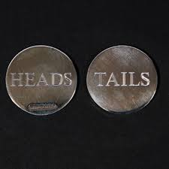
Heads, Hearts, and Tails
Distillation traditionally distinguishes between the light factions that come over first (Heads), the body that we want to collect as product (Hearts), and the heavy factions at the end of the run (Tails);
Lighter factions need less energy and speed to come over, heavier factions need more energy and speed to come over;
Vapor speed management is about creating the vapor speed that allows you to harvest the desired alcohols and related congeners!

Slide 25
Factions and tastes
Heads: fruit associated tastes;
Hearts: body;
Tails: nutty and rooty tastes.
Different drinks are favored by different sets of congeners!

Slide 26
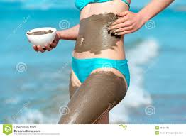
Drinks and smearing
Fruit brandy (fruity flavors):
The still should favor low vapor speeds (for Heads control), bubble cap plates (to prevent Tails coming over), smearing of Heads into Hearts, copper for sulfur control, agitator for pulp, copper to further lessen efficiency of gross/net energy input and bring down vapor speeds even more.
Rum, whisky: (nutty, rooty);
The still should favor high vapor speeds (for Tails control and the smearing of early Tails into Hearts), no bubble caps if you want a heavy whisky (fixed liquid baths prevents early Tails smearing), if possible direct fired for additional Maillard Reaction in the boiler (taste cascade), power management to effectively manipulate smearing.
Vodka (get rid of tastes):
Many re-distillations for better separation of factions and Tails control, stabilization for Heads control. Removal of ultra compact Heads and Tails factions leaves a relative pure Hearts faction.

Slide 27
Now focus on fermenting!
Have you choosen the right rig to help you make great product?
You probably spent too much time in making that decision!
Why?
Because 80% of the taste of your product is made during fermentation.
During fermentation, not during distillation!

Slide 28
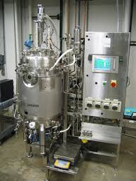
Now focus on fermenting!
Most Craft Distillers spend 80% of their time and money on distilling equipment;
Advice: spend 80% of your time and money on finding the right fermenting equipment!
It will pay off in terms of product quality and product consistency;
Trend 2016/2017: controlled fermentation as standard modus operandi.

Slide 29
Now focus on fermenting!
Hotter ferments for more fruitiness;
Cooler ferments for less fruitiness;
But follow the yeast and give it what it needs:
  Temperature wise;
  pH wise;
  Nutrients wise;
  ABV wise.
Trend 2016/2017: hotter fermentation as standard modus operandi using simple baker’s yeast.

Slide 30
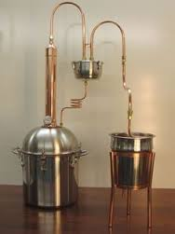
Every distillery deserves 10,000 smaller distillation devices
Why? Because I like to sell distillation equipment? Sure, but there is more.
Current situation: more re-distillations create better Heads and Tails control, but comes at incredible costs:
Investment and running costs (ever asked for a quote on a 40 plated still?);
Thin tasting Hearts for taste rich products, while vodka still needs filtering;
Versatility: fixed column and plates can be bypassed but still need heating.

Slide 31

Dream on, Odin!
“What if we could fill the complete column with thousands of 1 inch nano distilleries, instead?”
“What if every nano distillery in that column performs one distillation cycle … wouldn’t that mean we only need a 14 inch instead of a 14 feet column to reach Azeotropic 96.5%?
“Shorter column means less material means less energy means more efficiency and lower total operating costs. More re-distillations translate to more control means higher and more repeatable output translating to more quality at lower costs …”
“And what if we could turn these nano distilleries off … and on … couldn’t we then combine the best of both worlds: perfect compaction of Heads and Tails, while at the same time choosing either ultra pure Hearts for vodka or 60% for taste rich barrel aged products?”

Slide 32

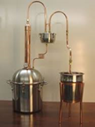
“A column with lots of small distilleries, like this, Odin?”
<= <= <=
Column with lots of small distilleries!
Yes, more or less!
“Now, how about performance? Do
we really only need 14 inches to reach
96.5% pure Azeotrope?”
Well … actually if we optimize
everything, we only need 11 centimeters!

Slide 33




“And how would you supply them with liquids, and turn them on/off?”
<= <= <=
Reflux fills nano stills from above. Gases rise from the bottom. They mingle and redistill!
They fill from above with reflux.
That turns them on so they start distilling.
“And how to turn them off, if we want
to make whisky or rum or brandy?”
By managing reflux amounts exactly!
Richer gases travel upwards, lower ABV reflux travels to the boiler.

Slide 34
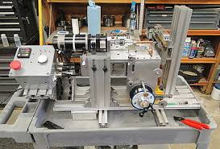
Dream on, Odin!
“Odin, you’d need a new column management design to make sure you can supply those nano distilleries in your column with the exact amount of liquids and gases to turn them on/off! Forget about it. Won’t be possible! Go back to the Handbook 1860!”
“And you’d need a simple and relatively cheap design to cost effectively produce those nano distilleries!”
“You probably need to manage those nano distilleries or your column via a computer, so you can check and re-check over and over again and turn them on/off like every second or so, when needed, given certain product specifications, right? I mean, no human can monitor that well, act that quickly! Software! You’d need optimization programming! Don’t see that happening any time soon!”

Slide 35
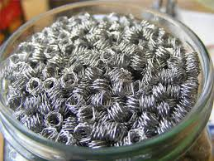
Dream on, Odin!
The last few years we have perfected the design and fabrication of these nano distilleries in different sizes (depending on column diameter and thanks to the Mendelev Institute);
We also developed a water temperature and air pressure independent column management system called RALM;
We have added a robot section that, depending on the product parameters you put in, turns those nano distilleries in the column on/off (we found out 0.02 mm accuracy is needed, that’s why we needed a robot);
We developed a computer to monitor every part of the column with 0.1 degree accuracy every second (5 probes);
And we wrote the software to translate your distilling wishes into automated robotized actions (with feedback and feedforward loops, making it capable of learning);
So you can spend more time with mashing, fermenting, cleaning, and pumping stuff around!

Slide 36
Distilling in the 21st Century
Beardles? At least with an emphasis on total process control and bottle-neck management via integrated turn-key distilleries;
Where copper is a means and not an end;
With a bigger focus on fermenting instead of distilling;
And where columns packed with nano distilleries will replace traditional pot and plated stills;
Robotization, automation, and user interfacing will take the guess work out of your operation, and give the Craft Distiller perfect control over vapor speeds as well as the art of smearing;
While dramatically reducing your investment and operating costs by factor 10 to 20.

Slide 37
Under pressure!
(Or … Distilling in the 22nd Century?)

Slide 38
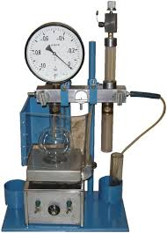
Distilling in the 22nd Century
By replacing existing designs by 21st century designs, we reduced capital investment while boosting energy efficiency;
I then decided to look where more gains could be found;
Vacuum distillation takes place at lower temperatures, so energy input is lower;
It turns out that making cuts, however, is a bitch under vacuum;
Lower boiling points also means that all boiling points group more closely together.

Slide 39
So … ?
So I thought: “What if we, instead of lowering the pressure, raise the pressure a bit?”
My thinking: “Offer some of the efficiency gained with the new technology to distill at higher instead of lower pressures … and maybe the associated higher boiling temperatures push the boiling points of all factions further away from one another …
… thus making cuts for Heads, Hearts, and Tails easier.

Slide 40
The results … ?
To my astonishment we got perfect separation of each and every Heads faction at its own temperature, just by adding a bit of pressure to the column;
Acetones came over at 27.9 degrees Celsius, for example, drip by drip, followed by some methanol, at a slightly faster drip rate at 64,7 C, followed by ethyl acetate came over at 77,2 C;
And after that the most taste rich Hearts I ever had.

Slide 41
The results … ?
With pressure management, we reached perfect separation and compaction of the Heads faction with a 3 feet column instead of a 90 feet column.
By manipulating pressure, we were then able to collect Hearts at the perfect aging strength of 60% in one go. So no more need for a double distillation approach. One run will get you there. And no longer any need to dilute your drink prior to barrel aging.

Slide 42
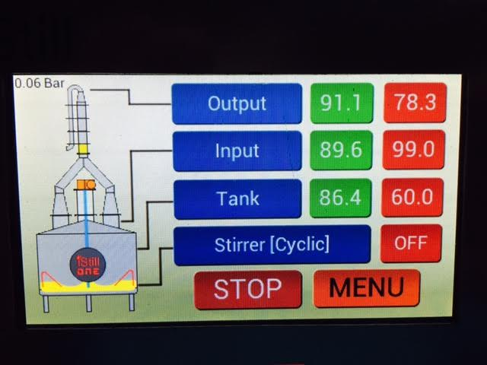

Slide 43
Thank you!!!

