Slide 1

Distilling ... made sustainable
@
Positive Spirits Event - London
By Dr. H.E.J. “Odin” van Eijk, MScBA, etc.
Founder, Owner, CEO of iStill

Slide 2
Who the heck are Odin and iStill?
Odin:
Change manager, disruptor, innovator, inventor
Working in the distilling industry
With over a decade of experience as a still designer
iStill:
World’s leading manufacturer of distillation equipment
>1300 customers
Started just 10 years ago

Slide 3
Leitmotiv
Distilling made easy:
Let’s make it easier to become a craft distiller!
Distilling made sustainable:
Let’s make distilling sustainable, both environmentally and businesswise!
How do we achieve that?
Through innovations, that is how I got started!

Slide 4
Insulation
As I was running it 2 or 3 times a day, my first little still used quite some energy, 15 years ago
By insulating the boiler and column, I saved 15 to 20% of energy
Better for the environment &creates lower costs for the distillery, and is an option now available to all craft distillers …
That consider running iStills!

Slide 5
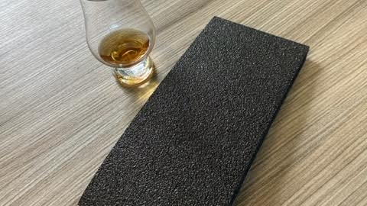

Slide 6
Automation
As l was innovating and doing 2 or 3 runs per day
Distilling took up 10 to 12 hours every day
By automating the still, I could save 70% on my workload and ”delegate” the most repetitive and boring tasks
This innovation allows for a focus on selling product, vs. making it, leads to a more motivated workforce, while saving you money

Slide 7
Process control
As l was innovating and doing 2 or 3 runs per day
I lost about 15% of my spirit production to heads and tails
By adding process control, distilling became more precise
This innovation limits heads and tails losses to 5%, while increasing yield by a whopping 11%!

Slide 8
Robotization & Column packing
To make whisky or rum, one needs to distill two times
The traditional double distillation method costs twice as much time and energy
By inventing robotization & column packing, whisky and rum can now be made in one (1) distillation run
This innovation produces spirits that are more flavorful, while saving 50% on energy consumption!

Slide 9
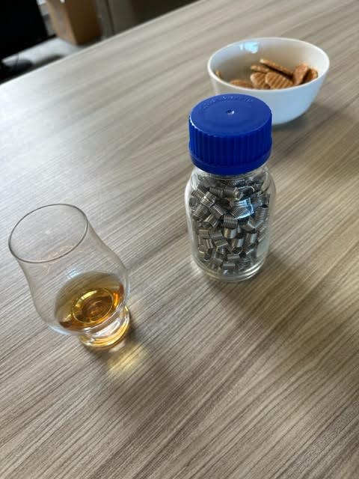
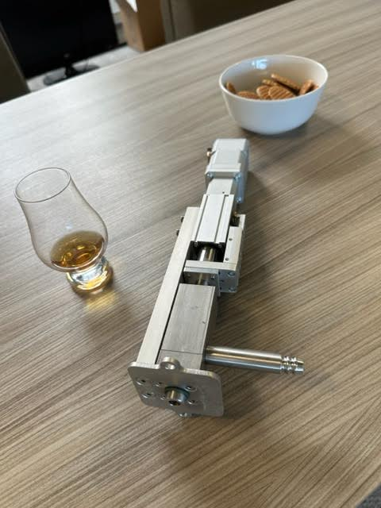

Slide 10
Reflux capacitor
In a column, up to 20% of the distilled spirit falls back into the boiler
This is of course a huge distilling-related inefficiency
The reflux capacitor catches the return liquid and redistills it
This alone lowers energy expenditure and distillation time by 20%!

Slide 11
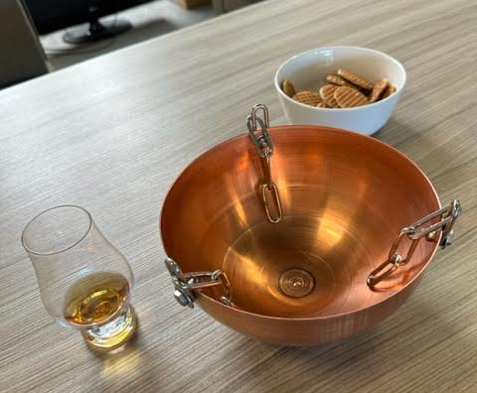


Slide 12
Thinking inside the box
Whisky production requires a masher, a fermenter, and a still
Mashing, fermenting, and distilling are all about heating up and cooling down, and all take place in a boiler ….
… so by inventing the iStill single vessel distillery, whisky can now be made in one (1) boiler instead of three
This innovation saves 50% in equipment investment costs and about 30% in energy consumption!

Slide 13
Copper waffle
Fermentations sometimes create excess sulfur and bad flavors
As copper catalyzes sulfur, copper stills have been the traditional counter-measure
But copper rusts, is expensive, and contaminates your spirit with a toxic heavy metal. Also, copper mining is horendous!
Our copper waffle has the same surface area as a copper column, but without the costs, the cleaning, or copper contamination, with just 1% of the actual copper

Slide 14
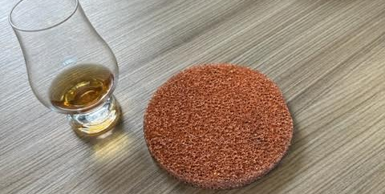

Slide 15
Designing & Building 2x
Still builders’ business models heavily rely on distillers purchasing replacement parts
So they design stills at 1x the strength calculation
By designing & building stills at 2x the strength calculation, longevity quadruples, while maintenance requirements drop by 75%
Our 2x design philosophy saves you a lot of money and saves the environment a shitload of non-sensical energy wasting

Slide 16
Distilling made sustainable
Is not only a possibility, but already a reality!
Due to the technological innovations discussed before
Over 1200 distillers already use it
Overall energy efficiency goes from 25% to 90%
Time spent doing reptitive work drops by 70%
Significantly lower production costs
Optimized profit margins improve longterm survivability
With a 75% reduced environmental footprint!

Slide 17
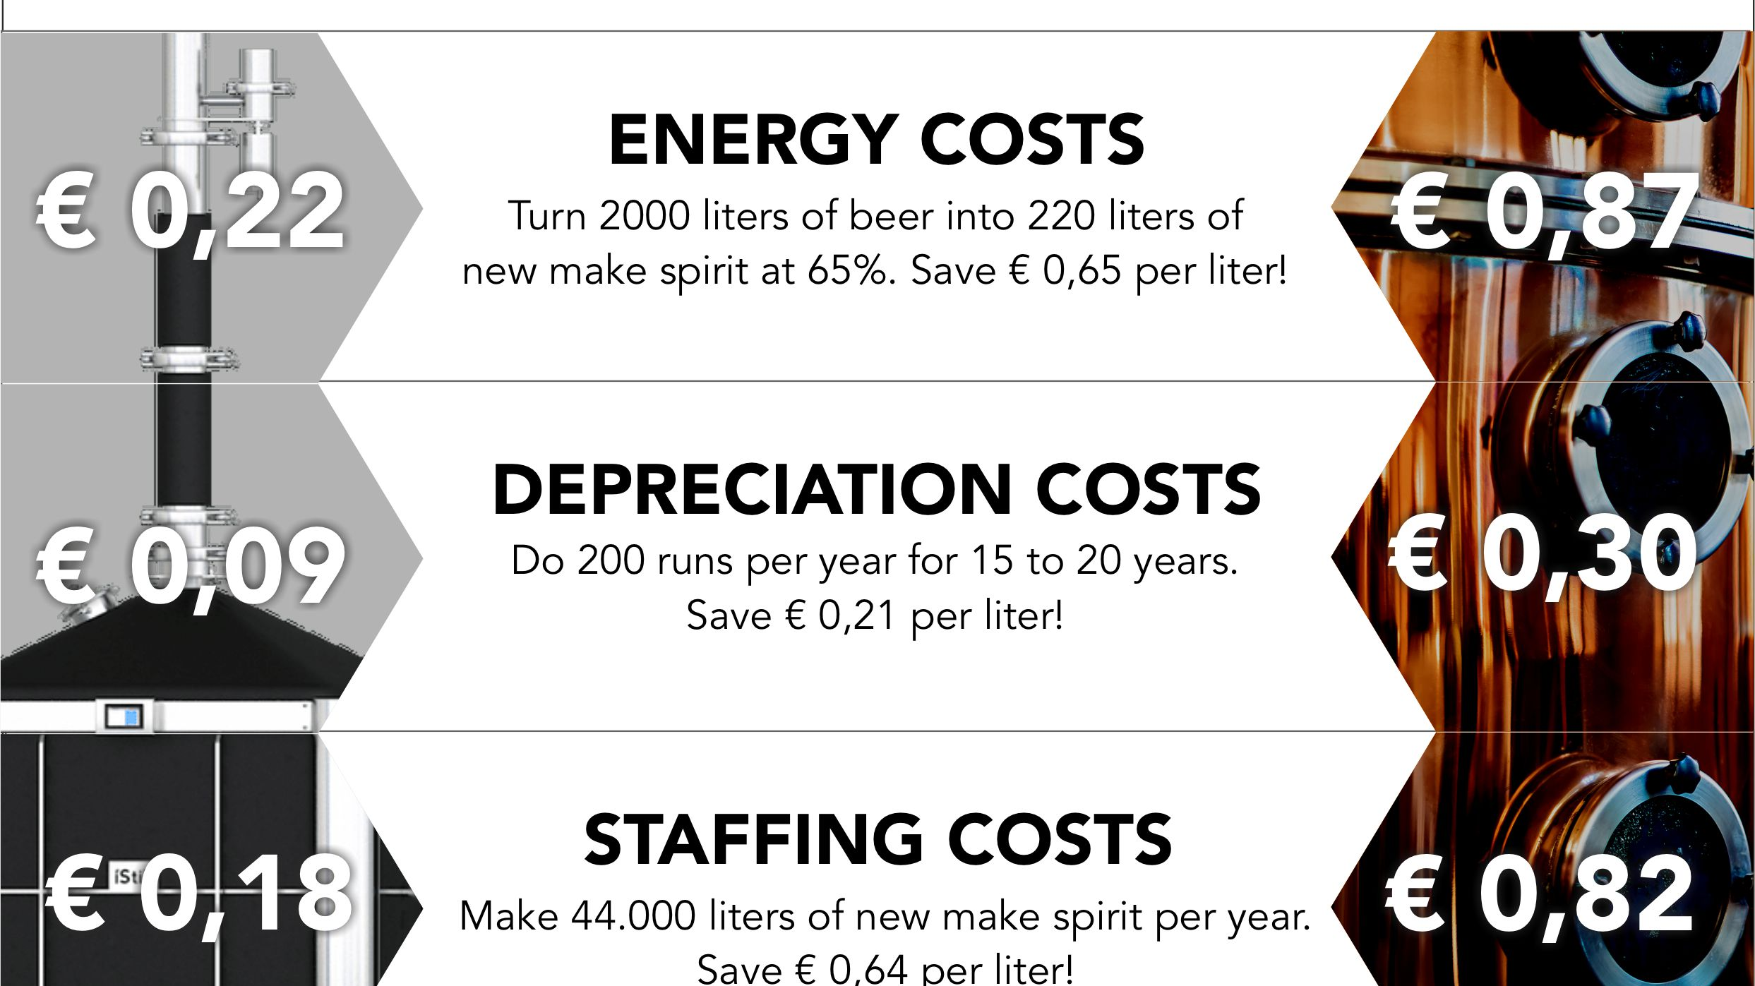

Slide 18
Thank you!
(any questions?)

